Slide 1
TCP/IP Network Fundamentals
UEEN2013/UEEN2423
(Topic 03)
Subnetting, VLSM and Summarization

Slide 2
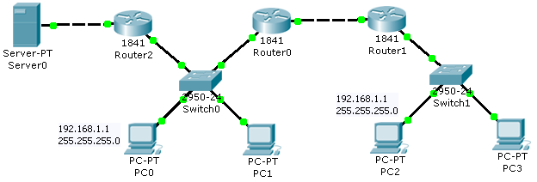
IP Subnet Rule #1
Every IP address within the “closed” network has to be unique.
There can’t be two same IP addresses in the network
Same applies to the Public IP addresses in the Internet
PC0 and PC2 can’t have the same IP in this network

Slide 3
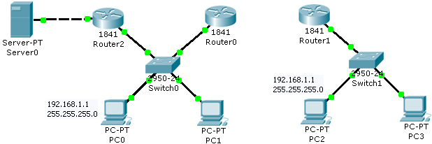
IP Subnet Rule #1
The following networks is okay (for having same IP addresses) since they are separated.
There are two “closed” network in the diagram.

Slide 4
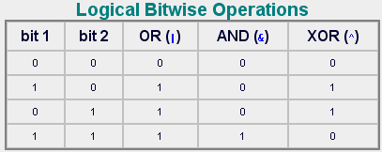
IP Subnet Rule #2
The function of a subnet mask is to divide the IP address into two parts: The Network ID and the Host ID.
The more important part is to produce the Network ID
Subnet mask by itself is meaningless.
It has to “work” with an IP address.
The process of getting the networking ID is the perform a bitwise AND operation between the IP and subnet mask.

Slide 5
IP Subnet Rule #2
An example of the process of getting the network ID and host ID:
IP address = 128.143.137.144
Subnet mask = 255.255.0.0
Network ID = (128.143.137.144 & 255.255.0.0) => 128.143.0.0
Host ID = 137.144 (of network 128.143.0.0)
This is just a simplified demonstration, in fact you need to convert the decimal form to binary form, order to perform the ANDING operation:
Network ID
Host ID
128.143
137.144
IP address

Slide 6

IP Subnet Rule #2
Another example to determine what the network ID is, for any given IP address
you have to convert both octal addresses into binary, and do a bitwise AND operation.
An example using an IP address of 156.154.81.56 used with a network mask of 255.255.255.240 follows:
This translate to a network ID of 156.154.81.48
Sometimes, network ID is also called network address or subnet address

Slide 7
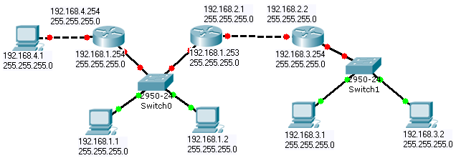
IP Subnet Rule #3
Network address within a “closed” network is preferred to be unique.
Network ID=
192.168.2.0
Network ID=
192.168.4.0
Network ID=
192.168.1.0
Network ID=
192.168.3.0

Slide 8
Packet Tracer Example
In the following network, though every IP address is unique, but the network ID is not unique, hence the following network won’t work.
You may try to build this network in Packet Tracer.

Slide 9
IP Subnet Rule #4
For a correct and valid 32 bits subnet mask: Left all ‘1’ and right all ‘0’
1111111.11110000.00000000.00000000 (valid)
11111111.11101101.00000000.00000000 (not valid)
Subnet mask can’t have a ‘0’ between two ‘1’s or a ‘1’ between two ‘0’
There are only 32 valid subnet masks (theoretical maximum).
255.0.0.0, 255.128.0.0, 255.192.0.0, ……. 255.255.255.255
Can be represented by ‘/’ notation
e.g. /9, /24, etc
/10 means ten ‘1’ from the left, and the remaining 22 bits are ‘0’
192.168.1.15/24 =>
This interface has an IP = 192.168.1.15
The subnet mask = 255.255.255.0
Belongs to network 192.168.1.0

Slide 10
Rule #4: Variable Network ID bits
Since functional subnet masks can range from /8 to /30, which means the network ID bits are also varies depending on the subnet mask.
This will cause the network ID to be the same for some subnet masks but different in some other cases.
Be careful on your design.
Network ID
Network ID
192.168.12.1/30 => 192.168.12.0
192.168.12.1/29 => 192.168.12.0
192.168.12.1/28 => 192.168.12.0
192.168.12.1/27 => 192.168.12.0
192.168.12.1/26 => 192.168.12.0
192.168.12.1/25 => 192.168.12.0
192.168.12.1/24 => 192.168.12.0
192.168.12.1/23 => 192.168.12.0
192.168.12.1/22 => 192.168.12.0
192.168.12.1/21 => 192.168.8.0
192.168.12.1/20 => 192.168.0.0
192.168.12.1/19 => 192.168.0.0
192.168.12.1/18 => 192.168.0.0
192.168.12.1/17 => 192.168.0.0
192.168.12.1/16 => 192.168.0.0
192.168.12.1/15 => 192.168.0.0
192.168.12.1/14 => 192.168.0.0
192.168.12.1/13 => 192.168.0.0
192.168.12.1/12 => 192.160.0.0
192.168.12.1/11 => 192.160.0.0

Slide 11
Rule #4: Size of Host ID bits
From the subnet mask, not only we know that size of network ID bits, but also the size of the host bits.
32 bits = network ID bits + host ID bits
For example, /25 =>
25 network ID bits with (32-25) = 9 host ID bits.

Slide 12
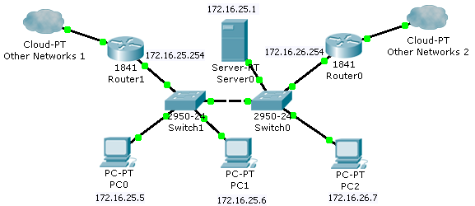
IP Subnet rule #5
In order to communicate within the “LAN”, the IP address of all hosts and gateways must have the same network ID.
All IP in the same subnet should be designed to have the same network ID.
That includes PC IP, server IP, and gateway IP.
For the following example:
If subnet mask = /16, all PC IP, server0 IP, and gateway IP will be able to communicate with each other
If subnet mask = /24, gateway IP of Router0, and PC2 WON’T be able to communicate with the rest.

Slide 13
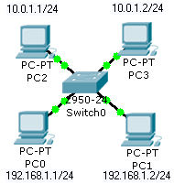
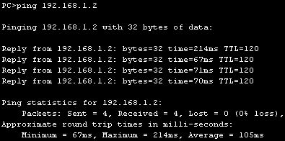
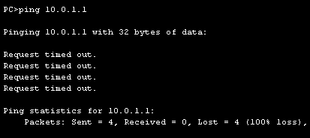
IP Subnet rule #5
PC0 can ping PC1
PC0 can’t ping PC3
Design guideline:
In order to communicate with each other in a LAN, any IP connecting to a switch should share a same network address

Slide 14
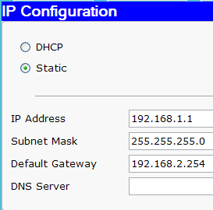
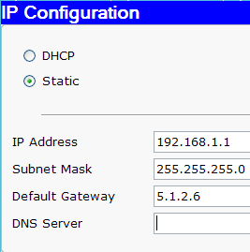
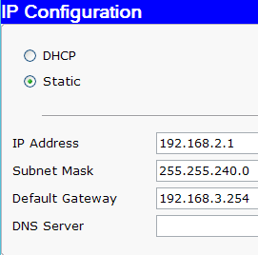
Application of Rule #5 in Gateway IP
Remember that gateway IP has to be in the same network ID with the rest of the host IP.
Otherwise, your subnet won’t work properly.
So, please DON’T design your gateway IP as the following example.
This is okay.
Don’t do this.
Don’t do this.

Slide 15
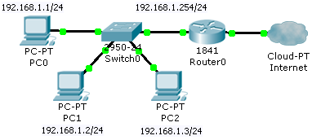
IP Subnet rule #6
If the data’s destination IP does not have the same network ID as the source IP, the data have to be sent to the gateway (router).
In most cases under Windows XP, the data with destination IP that does not have the same network ID will be sent to default gateway.
The default gateway IP will be utilized in ARP.
Destination MAC address of default gateway will be used.
If PC0 wants to:
ping 192.168.2.1
ping 180.7.4.3
ping 10.0.1.1
The data has to be sent to the gateway

Slide 16
IP Subnet rule #6
Example for rule #6:
PC0 (192.168.1.1) ping 10.0.1.1
Check for source IP network ID
192.168.1.1 & 255.255.255.0 = 192.168.1.0
Check for destination IP network ID
10.0.1.1 & 255.255.255.0 = 10.0.1.0
The source IP network and the destination IP network mismatch
The host need to send the packet to the default gateway
The subnet mask used in both cases, is the subnet mask of source IP’s PC

Slide 17
IP Subnet rule #6
The algorithm for rule #6:
Command destination_IP (e.g. ping 10.10.1.1)
If (destination_IP & my_PC_subnet_mask == source_IP & my_PC_subnet_mask)
This means the destination IP is within same LAN,
Check arp_table for this IP address for MAC address. (if not send out arp to get this IP’s MAC address)
Send the frame out to the IP address which is in the same LAN
If (destination_IP & my_PC_subnet_mask != source_IP & my_PC_subnet_mask)
This means the destination IP is not in the same LAN
Check OS for default_gateway_IP
Check arp_table for the MAC address of default_gateway_IP
Send the frame to the default gateway.

Slide 18
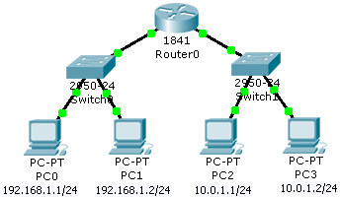
IP Subnet rule #7
Router MUST be used in order for two hosts with different network address (or network ID) to communicate.
Communication will not happen between hosts with different subnets address that are connected to a switch
A switch only provides communication for the PCs with the same network ID
Two different subnets has to be communicated via a router.

Slide 19

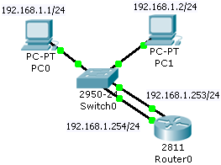
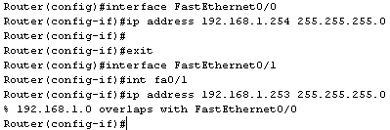
Rules #7 in Router
Based on rule #7, IP addresses set in a router ports have to be in different subnet.
Meaning IP addresses set in router ports can’t be in the same subnet
The router IOS will complain.
The router won’t allow you to set it.
The following example won’t work.

Slide 20
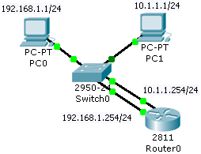
Example network of IP Subnet Rules #7
The following example WORKS, despite a little strange.
The network does not violate any subnet rule. In fact, it embrace them. (1 LAN 2 IP subnets)
The following network embraces IP subnet rule 5, rule 6 and rule 7
Rule 5: Two PC can’t communicate with different subnet address within a LAN
Rule 6: Data need a gateway to exit to another subnet.
Rule 7: You need a router for communication between 2 subnets.

Slide 21
IP Subnet Rule #8
Two special cases on host ID bits which are all ‘0’s and all ‘1’s
When Host ID bits are all ‘0’s, it is a network address.
When Host ID is all ‘1’s, it is a broadcast address, we don’t use it as a host address too.
These two addresses represent the “head” and the “tail” of the given IP address block range.
We CAN’T use both of these IP addresses as host IP and gateway IP.
Example, IP address = 192.168.1.1, Subnet mask = 255.255.255.0
Network address of the subnet = 192.168.1.0
Broadcast address of the subnet = 192.168.1.255

Slide 22
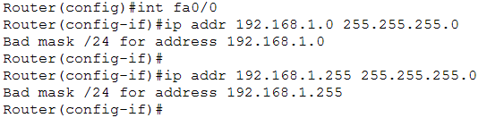
Rule 8 in Router
Router won’t accept network address and broadcast address as its port IP address.
In the following example, the router will “complain” in both cases and won’t accept the IP addresses with the given subnet mask:
IP = 192.168.1.0 subnet mask = 255.255.255.0
IP = 192.168.1.255 subnet mask = 255.255.255.0

Slide 23
What is a broadcast address?
A broadcast address
is a network address that allows information to be sent to all nodes on a LAN, rather than to a specific network host.
Broadcast is used in ARP and DHCP.
Router will stop broadcast from reaching other subnets.
Sometimes, IP subnets is also called a broadcast domain.

Slide 24
IP subnet rule #9
The first usable IP and the last usable IP.
Usable IP addresses mean they can be used in hosts, PCs, printers, gateways, and servers.
The first usable IP = network address + 1
More precisely, host ID = 1
If network adress = 192.168.3.0, first usable IP = 192.168.3.1
The last usable IP = broadcast address – 1
More precisely, host ID = All ‘1’s – 1
If broadcast address = 192.168.3.255, last usable IP = 192.168.3.254
Cisco guidelines (not rules):
Last usable IP is preferred to be
router IP address = gateway IP
First usable IP is preferred to be
server, printer
any host that requires static IP

Slide 25




LAN IP design guideline
Given a range of IP address:
First IP addresses are preferred to be used for setting static IP for servers and printers
Starting from the first IP and counting down
e.g: 192.168.1.1 for DHCP server; 192.168.1.2 for printer
Last IP addresses are preferred to be used for setting router IP (gateway IP)
Starting from the last IP and counting up.
e.g. 192.168.1.254 for gateway 1, 192.168.1.253 for gateway 2.
Mid-range IP addresses are preferred to be set as the DHCP range for the PCs
e.g 192.168.1.10 to 192.168.1.250
In this range, we reserve 10 first IP for servers and printer and 5 last IPs for gateways
First IP
e.g. 192.168.1.1
Static IP
Static IP
Mid-range IP
Dynamic IP
e.g. 192.168.1.254
Static IP
Last IP

Slide 26
Why Last Usable IP for Gateway?
Case study:
Router locked with password, you don’t know the password and the router IP, and you are new to the job.
What do you assign?
Do you have to test 254 IP to find the IP? Provided that you know the subnet mask is /24.
Technically, you can assign any usable IP in the range for the default gateway IP.
If last usable IP rule is followed, you can guess it easily.
If the gateway IP is set in the beginning of the range (e.g. 192.168.1.3), chances is very high that you set an host IP which is the same as the default gateway IP.

Slide 27
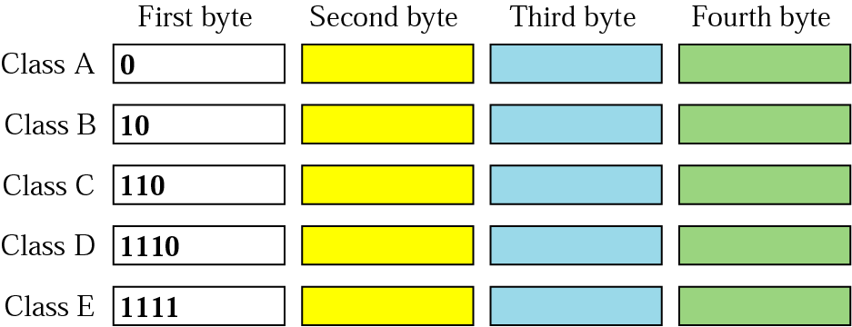
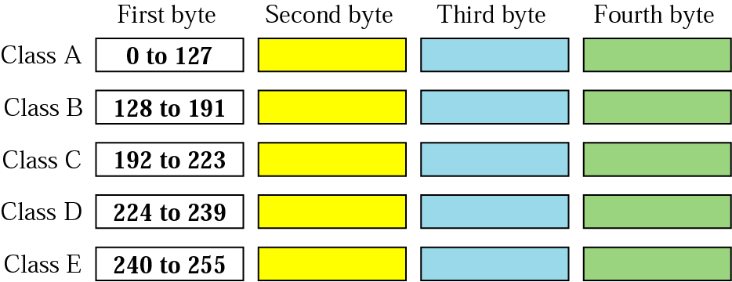
IP Subnet Rules #10
When Internet addresses were standardized (in early 1980s), the IP addresses were divided up into 5 classes:
Class A:
Network prefix is 8 bits long.
Default mask: 255.0.0.0. or /8
Class B:
Network prefix is 16 bits long.
Default mask: 255.255.0.0 or /16
Class C:
Network prefix is 24 bits long.
Default mask: 255.255.255.0 or /24
Class D:
is multicast address
Class E:
Experimental

Slide 28
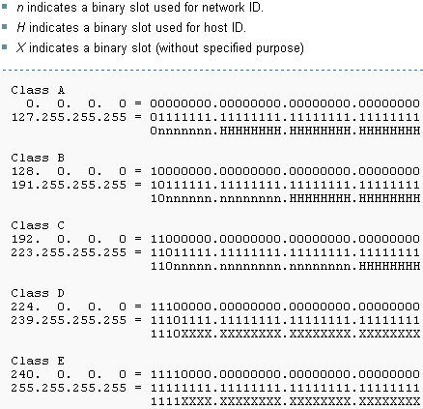
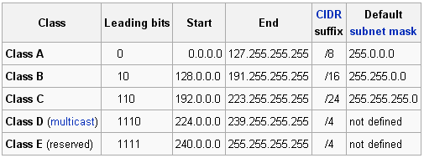
IP Subnet Rules #10
We can only use class A, B, and C for host IP address.
Class A, B, C IP addresses are called unicast IP address
We CAN’T use class D and E IP address for “normal” IP address.
Class D IP addresses are called multicast IP addresses
Class D IP usage is quite different from class A, B, C.

Slide 29
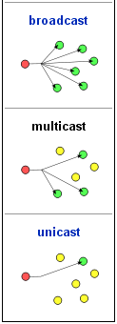
Broadcast, Multicast, Unicast
Broadcast
One to all
Used in DHCP, ARP
Multicast
One to many
Class D IP
Normally used in streaming IP TV or streaming radio
Unicast
One to one
Class A, B, C IP
What we have been using…

Slide 30
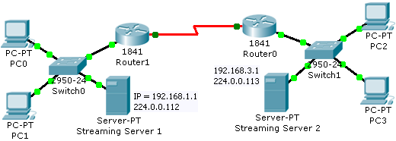
IP Subnet Rules #10
Unicast IP = 1 device 1 IP
Multicast IP = all devices that “tune into that channel” share the IP
Unicast IP and multicast IP can be used at the same time in 1 host.
Example in the following diagram:
Two streaming servers with multicast IP (224.0.0.112 and 224.0.0.113)
For example streaming web cam videos.
All PCs and servers still require their unique IP address
If all PC “tune in” the “channel” of 224.0.0.112, all PCs and Streaming Server 1 will share the same multicast IP (224.0.0.112) on top of their own unicast IP address.

Slide 31
IP Subnet Rules #11
The range of private IP addresses which is NOT used in public IP address for global Internet.
The Internet Assigned Numbers Authority (IANA) has reserved the following three blocks of the IP address space for private internets (local networks):
10.0.0.0 - 10.255.255.255
172.16.0.0 - 172.31.255.255
192.168.0.0 - 192.168.255.255
IANA has reserved private the following IP addresses for Automatic Private IP Addressing (APIPA) for Windows platform (except NT).
169.254.0.0 - 169.254.255.255
APIPA is used in Windows where the IP address (169.254.x.x) is assigned automatically by the OS (after sometime) when the DHCP service is not available (and the option of “Obtain an IP address automatically” is on).
If the DHCP service is working fine in your LAN, and you still get the IP 169.254.x.x for your Windows IP, that only means your cable, connection or NIC is having problem.

Slide 32
Private and Public IP Address
Private IP addresses are the IP addresses that use at home (and at school), as your source IP.
You need to pay money for an Public IP address (monthly subscription).
And the domain name too (e.g. www.utar.edu.my, www.intel.com)
Public IP is global, and you need to apply and obtain it through IANA (maybe via Tmnet)
The range of Private IP (IMPORTANT !!!)
10.0.0.0 to 10.255.255.255
172.16.0.0 to 172.16.255.255
192.168.0.0 to 192.168.255.255
Private IP is not unique.
There are thousands of 192.168.1.1 in the world
Special IP = 127.0.0.1, is reserved to be the loopback IP address
To test the network software
The domain name localhost = 127.0.0.1

Slide 33
IP Subnet Rule #12
A host can have different IP addresses according to the number of network interface cards installed.
IP is an Network Interface address
A PC with 1 NICs requires 1 IP address
A PC with 3 NICs requires 3 IP addresses
One IP for each NIC
A router with 2 Fast Ethernet ports and 2 T1 serial ports need 4 IP address
One IP for each ports
A DNS server can have 2 NICs with 2 different IP addresses
Answer for the previous slide
From now on, “adjust” your previous thought on IP address is a network “host” address.
Meaning 1 IP = 1 host.

Slide 34
IP Rule #13
Host ID bits as LAN design parameter for allocating the number of PCs/hosts in a LAN.
For example: For a subnet with a mask of 255.255.255.128, how many hosts that we can allocate in that subnet?
255.255.255.128 => /25 => 32-25 = 7 host bits
2⁷ => 128 host ID => theoretically 128 IP address.
Actual allocation of PC/host IP = 128 – 1 – 1 – 1 = 125 IP address
Can’t use network address, broadcast address, and gateway address for PC/hosts. (Assuming 1 gateway in the LAN)
Host includes laptops, servers and printers.
If a LAN is desired to have 27 PCs, what should be the subnet mask?
Formula: 2^{H} ≥ “number of hosts” + 3; H = host ID bits
3 = 1 network address + 1 broadcast address + 1 gateway
2^{H} ≥ 27 + 3 => 2⁵ ≥ 30 =>
H = 5; Subnet mask = /(32-5) = /27 => 255.255.255.224

Slide 35
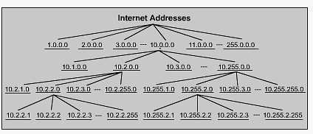
IP Subnet Rules #14
The principle of IP design in subnetting and supernetting
Subnetting
1 bigger network split into a few smaller networks.
Supernetting
2 or more smaller networks are joined into a larger network.
subnetting
supernetting

Slide 36
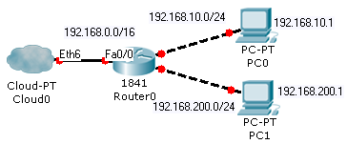
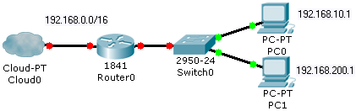
IP Subnet Rules #14
Supernetting
Subnetting

Slide 37
IP Subnet Rules #14
Split the host number portion of an IP address into a subnet number and a (smaller) host number.
Result in a few blocks of IP addresses.
The subnet mask will be extended with more ‘1’
The subnet mask will get larger.
network prefix
host number
network prefix
subnet number
host number
extended network prefix

Slide 38
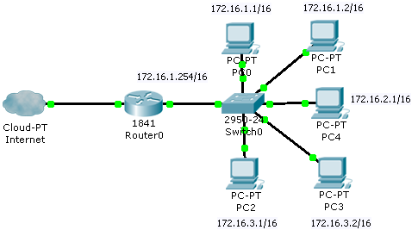
IP Subnetting example (1)
Perform subnetting for the following LAN.
172.16.0.0/16
Specification:
Subnet number = 8 bits.

Slide 39
IP Subnetting example (2)
Original subnet mask = /16
New extended subnet mask = /(16 + 8) = /24
16 bits
16 bits
172.16
0.0
network prefix
8 bits
Subnet #
8 bits
hosts
extended network prefix (24 bits)
New network prefix
8 bits
hosts

Slide 40
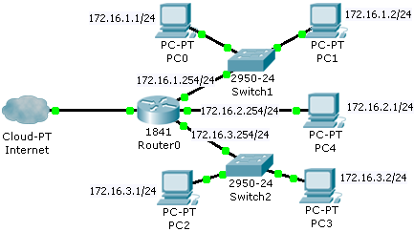
IP Subnetting example (3)
Implementation
Subnet 1 network into 3 LAN
1 network ID (172.16.0.0/16) becomes 3 network ID (172.16.1.0/24, 172.16.2.0/24, 172.16.3.0/24)
All subnet mask has been changed from /16 to /24
1 gateway -> 3 gateways

Slide 41
Types of Subnetting
Traditional classful subnetting
Based on the IP class to perform subnetting
Design with equal size subnet mask across “the network”
VLSM (variable subnet mask)
Design a network with subnets of different “size” of subnet mask
More efficient use of the IP addresses

Slide 42
Traditional classful Subnetting
First, determine which class does the IP belongs to
Class A (24 host bits), B (16 host bits) or C (8 host bits)
Second, determine how many subnet bits you want to allocate.
Third, compute the new subnet mask.
Fourth, plan the IP range of each subnet.

Slide 43
Traditional Classful Subnetting
There are two ways to determine the subnet bits (you can choose either one the following):
The number of subnets that you want to have in the network that you are going to “split”
For example, you want 10 subnets in the network, then you need S subnet bits. (2^{S} >= 10)
The maximum number of hosts that you want to allocate
For example, if you have a class B IP address, and you need maximum1000 hosts in any one of the subnet, then you need N subnet bits where ( 32 = 16 + S + H bits) 2^{H} >= 1000 => H = 10 bits. Then N = 32 – 16 – 10 = 4 bits.
16 is the original host bits for class B IP address.

Slide 44
Steps to Subnetting (1)
Case Study:
You have a Class C address of 192.168.100.0 /24. You need nine subnets.
What is the IP plan of network numbers, broadcast numbers, and valid host numbers?
What is the subnet mask needed for this plan?

Slide 45
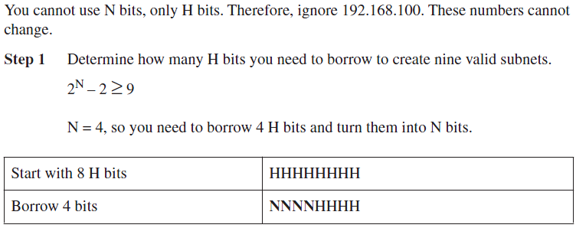
Steps to Subnetting (2)
Since the subnet mask is /24, we only need to focus on the 4th octet.
The 4 octet is the host bits, represented by ‘H’
The ‘N’ bits is the new “subNet” bits.

Slide 46
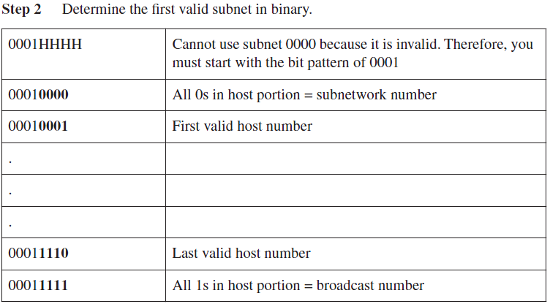
Steps to Subnetting (3)

Slide 47
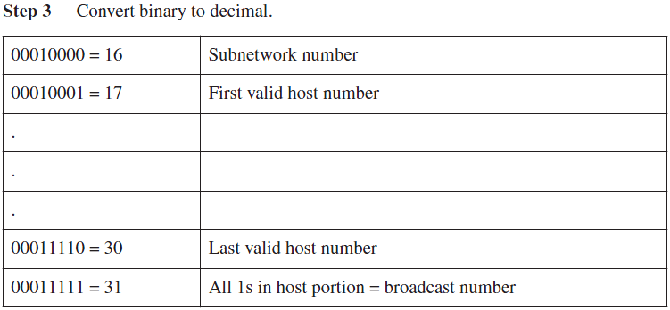
Steps to Subnetting (4)

Slide 48
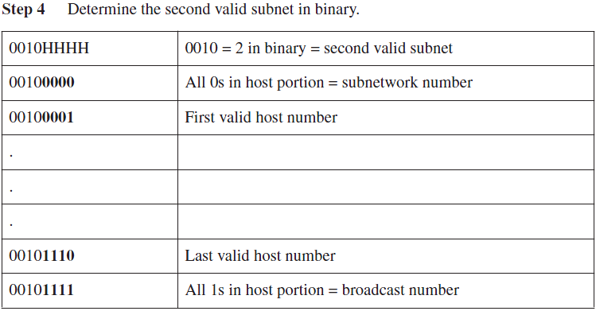
Steps to Subnetting (5)

Slide 49
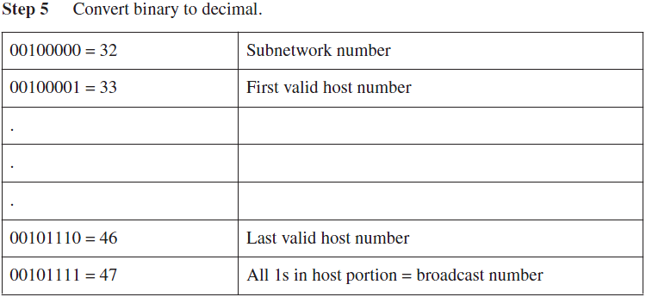
Steps to Subnetting (6)

Slide 50
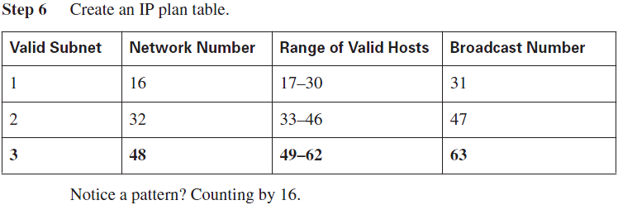
Steps to Subnetting (7)

Slide 51
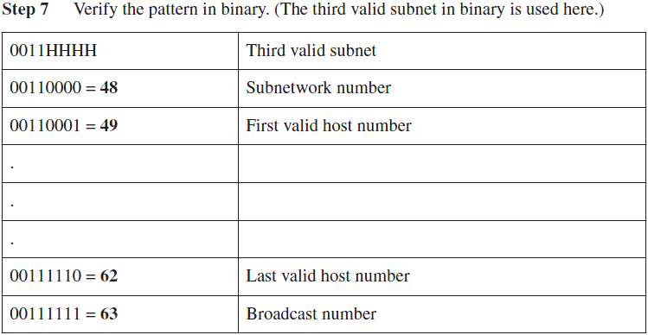
Steps to Subnetting (8)

Slide 52
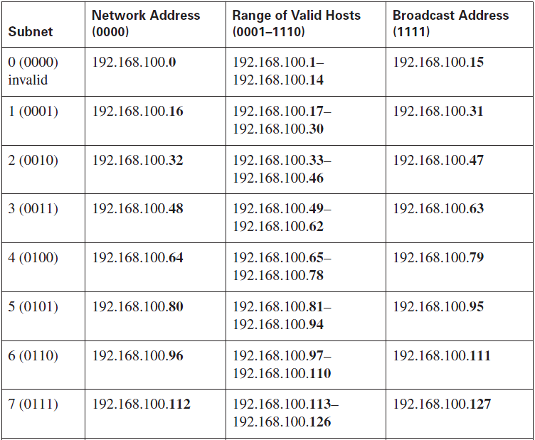
Steps to Subnetting (8)
Continue
next page

Slide 53
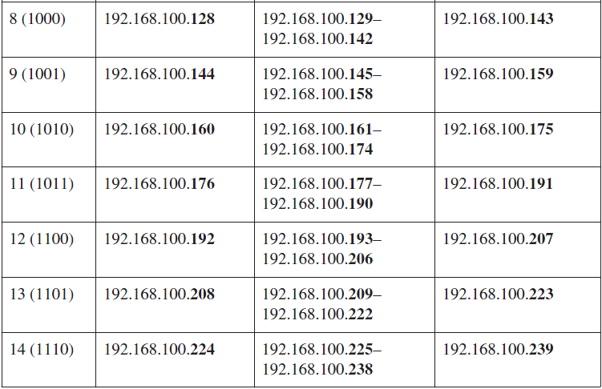
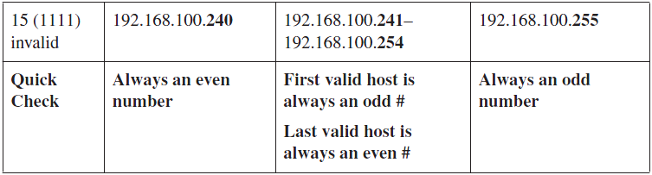
Steps to Subnetting (9)

Slide 54
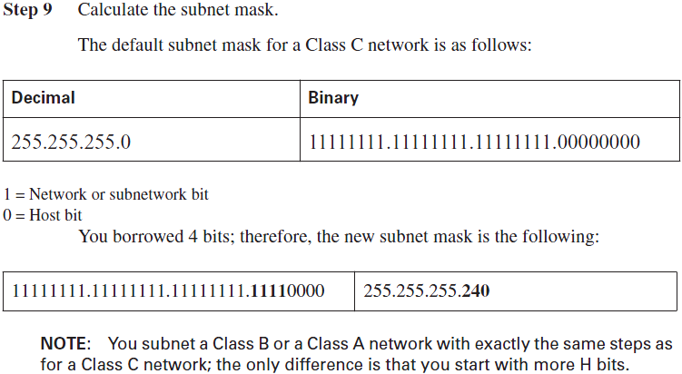
Steps to Subnetting (10)

Slide 55
VLSM (1)
Variable-length subnet masking (VLSM) is the more realistic way of subnetting a network to make for the most efficient use of all of the bits.
VLSM is the process of “subnetting a subnet” and using different subnet masks for different networks in your IP plan.
What you have to remember is that you need to make sure that there is no overlap in any of the addresses.

Slide 56
VLSM (2)
Remember that when you perform classful (or what I sometimes call classical) subnetting, all subnets have the same number of hosts because they all use the same subnet mask.
This leads to inefficiencies.
For example, if you borrow 4 bits on a Class C network, you end up with 14 valid subnets of 14 valid hosts. (instead of 16 subnets)
A serial link to another router only needs 2 hosts, but with classical subnetting, you end up wasting 12 of those hosts.

Slide 57
VLSM Example #1 (1)
Given the following network 192.168.1.0/24, how is it going to be subnetted?
We only need to take care of the 10 hosts subnet, 11 hosts subnet, and 30 hosts subnet.
Assume that there won’t be expansion on the number of host per subnet.

Slide 58
VLSM Example #1 (2)
Using the traditional subnetting methodology.
There are 3 subnets and the maximum # host in a subnet is 30.
Either we have 2 subnet bits or 5 host bits.
If we choose 2 subnets bit design (6 bits host), there won’t be much expansion on subnets but growth on hosts.
In this case, we choose 5 bits host design (3 subnet bits), as specified in the question.

Slide 59
VLSM Example #1 (3)
With traditional classful subnetting
192.168.1.64/27
192.168.1.32/27
192.168.1.0/27

Slide 60
VLSM Example #1 (4)
However, the traditional classful subnetting in this case, is not “IP address efficient”.
Given that there won’t be expansion on the number of host per subnet.
10 hosts subnet and 11 hosts subnet will have around 20 IP addresses (per subnet) that are not utilized.

Slide 61
VLSM Example #1 (5)
If we use VLSM scheme, this is how we are going to do it.
1st we choose the largest network 30 hosts
Host bits is still 5
We can still use the subnet of 192.168.1.1 to 192.168.1.30, which is 192.168.1.0/27
2nd we “group” the 10 hosts subnet and 11 hosts subnet into one “30 hosts” subnet.
We can use the subnet of 192.168.1.33 to 192.168.1.62, which is 192.168.1.32/27

Slide 62
VLSM Example #1 (6)
Now, we perform subnetting the subnet.
We subnet the 192.168.1.32/27 into two subnets.
With the help of IP calculator (using CIDR), we have:
192.168.1.32/28
Usable IP range 192.168.1.33 to 192.168.1.46
192.168.1.48/28
Usable IP range 192.168.1.49 to 192.168.1.62

Slide 63
VLSM Example #1 (7)
With VLSM subnetting
192.168.1.32/28
192.168.1.48/28
192.168.1.0/27

Slide 64
VLSM Conclusion
Looking at the plan, you can see that no number is used twice.
You have now created an IP plan for the network and have made the plan as efficient as possible, wasting no addresses in the serial links and leaving room for future growth.
This is the power of VLSM.

Slide 65
Route Summarization
Route summarization, is needed to reduce the number of routes that a router advertises to its neighbor.
Router summarization make the “combined” subnets appear to be a “supernet”
For every route you advertise, the size of the update and routing table grows.
Route summarization greatly reduces the size of the routing table
It has been said that if there were no route summarization, the Internet backbone would have collapsed from the sheer size of its own routing tables back in 1997.

Slide 66
CIDR
CIDR (Classless Inter Domain Routing) is also known as supernetting as it effectively allows multiple subnets to be grouped together for network routing.
CIDR was adopted to help ease the load imposed on internet and large network backbone routers by the increasing size of routing tables.
Large routing tables have several adverse effects:
Routers require more memory in order to store and manipulate their routing tables which increases operation costs.
Routing latency is increased due to the large amount of data contained in the routing tables.
Network bandwidth usage is increased by routing updates when routers exchange their routing tables.

Slide 67
CIDR
CIDR (Classless Inter-Domain Routing) encompasses:
the VLSM technique of specifying arbitrary-length prefixes.
An address in CIDR notation is written with a suffix indicating the number of bits in the prefix, such as 192.168.0.0/16, where /16 is the suffix, and 192.168.0.0 is the prefix.
the aggregation of multiple contiguous prefixes into supernets, thus reducing the number of entries in the global routing table.
Aggregation hides multiple levels of subnetting from the Internet routing table, and reverses the process of subnetting with VLSM.

Slide 68
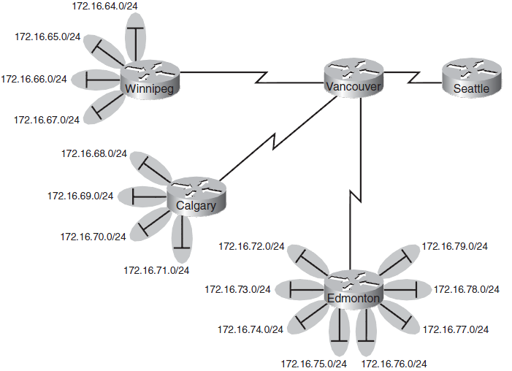
Route Summarization Example (1)

Slide 69
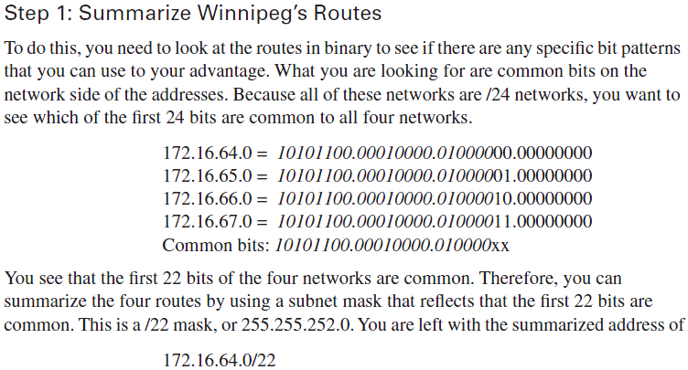
Route Summarization Example (2)

Slide 70
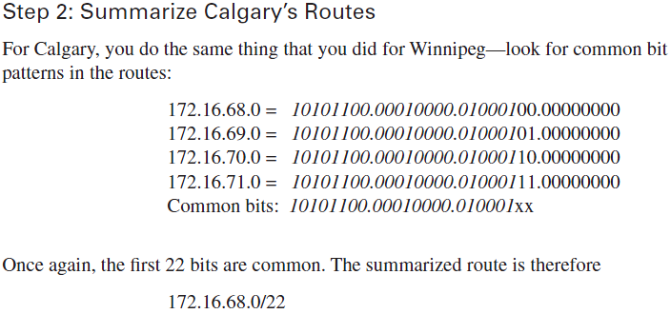
Route Summarization Example (3)

Slide 71
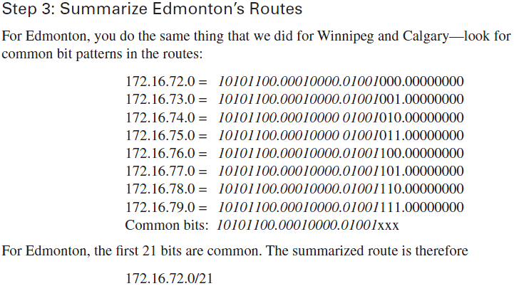
Route Summarization Example (4)

Slide 72
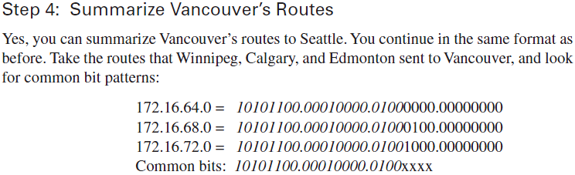

Route Summarization Example (5)
Try this supernetting with UTAR IP calculator (yourself)

Slide 73
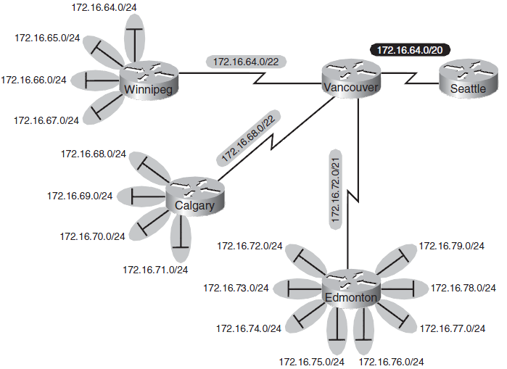
Route Summarization Example (6)

Slide 74
Supernetting & Route Summarization
Supernet and route summarization use the same IP address computation that combines a few IP of a few subnets into one.
The difference is that supernetting will physically combine a few subnets together whereas route summarization only compute the supernet network ID (in router) without changing the network.

Slide 75
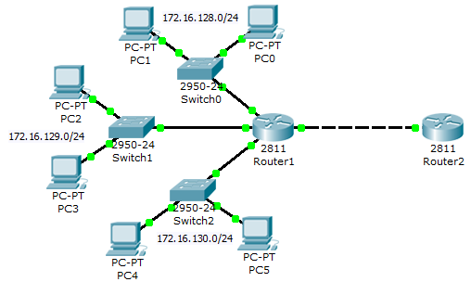
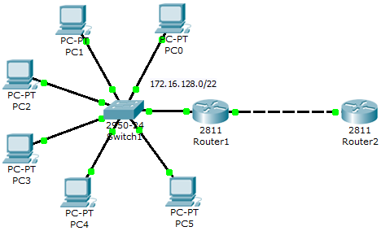
Supernetting & Route Summarization
Both route summarization & supernetting produce the same summarized IP network ID.
However supernetting changes the network topology.
Original
Route
Summarization
supernetting
172.16.128.0/22

Slide 76
Pros and Cons of subnetting
Pros:
Better security and management
More host IP being utilized within the subnet.
Cons:
Waste some host IP in the form of network address, broadcast address, and gateway IPs
Network design is more complex in order to perform the IP planning.

